Slide 1


Slide 2
Objectives
At the end of this session you will be able to
  Create and apply Master Pages.
  Create Nested Master Pages.
  Change Master Pages programmatically.
  Create a Skin file and apply theme to controls.
  Apply theme at application level.
  Apply Theme programmatically.
  Create custom themes.
  Disable Theming for a particular control.

Slide 3
Why Use Master Pages?
Standardized Web content Display for number of pages
Requirements for building and reusing pages efficiently:
  Pages should be easy to modify
  No deep recompilation of pages while making changes
  Minimal impact on the overall performance of the application while changing look & feel

Slide 4
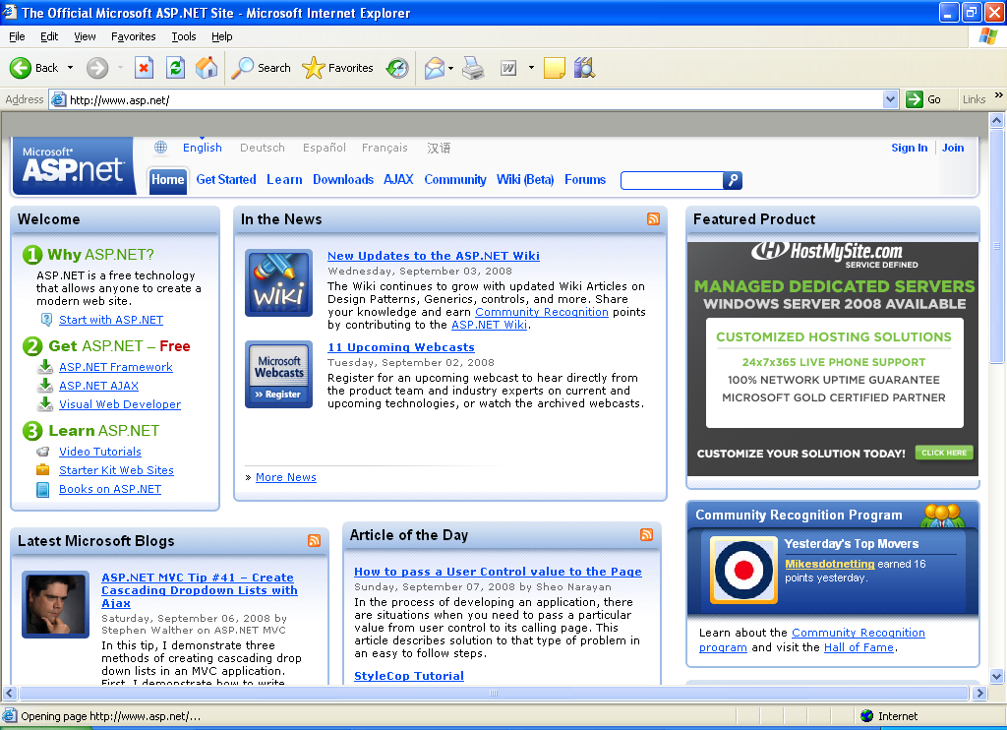
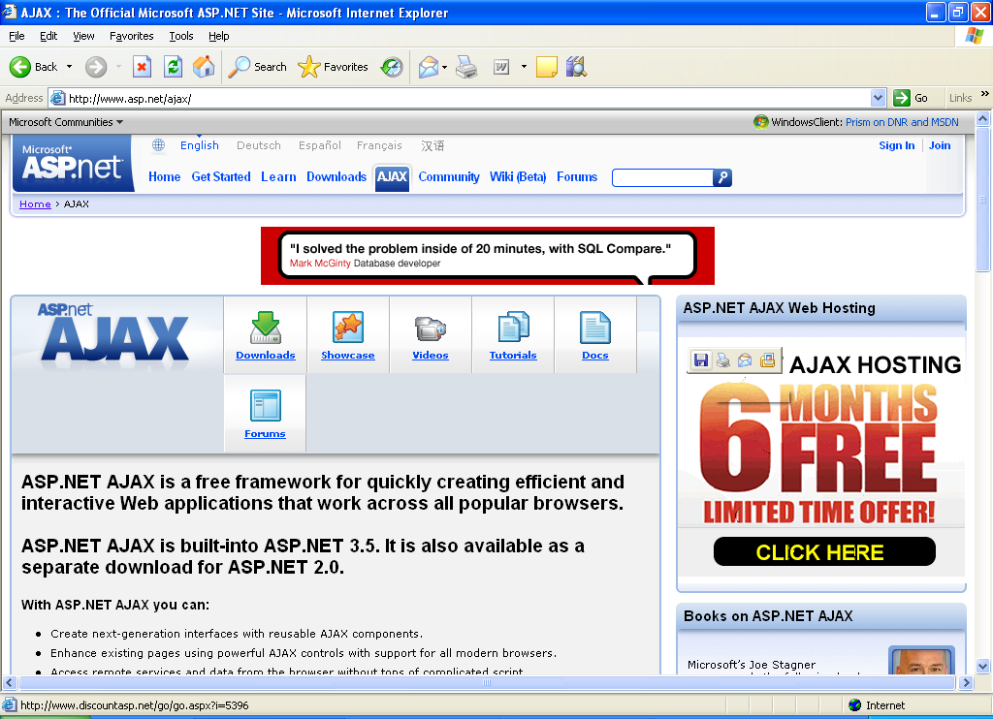
Master Pages
Master Page
Definition of a super template

Slide 5
The User Controls Approach
Best approach to authoring pages with a common layout in ASP.NET 1.x
Aggregates of ASP.NET server controls, literal texts, and procedural codes
Used for designing user interface controls , which can be used for other pages of a Web site
Few minor changes required to convert existing ASP.NET page into a user control
Not perfect solution while creating and managing large-scale and complex applications

Slide 6
Master Page Basics
Masters define common content and placeholders (<asp:ContentPlaceHolder>)
Content pages reference masters and fill placeholders with content (<asp:Content>)
default.aspx
http://.../default.aspx
<%@ Page MasterPage-
File="Site.master" %>
<asp:Content
ContentPlaceHolderID=
"Main" RunAt="server" />
</asp:Content>
<%@ Master %>
<asp:ContentPlaceHolder
ID="Main"
RunAt="server" />

Slide 7
Master Pages Basics
<%@ Master %>
<html>
<body>
<!-- Banner shown on all pages that use this master -->
<table width="100%">
<tr>
<td bgcolor="darkblue" align="center">
<span style="font-size: 36pt; color: white">ACME Inc.</span>
</td>
</tr>
</table>
<!-- Placeholder for content below banner -->
<asp:ContentPlaceHolder ID="Main" RunAt="server" />
</body>
</html>
Notes:
Programming ASP.NET
Copyright © 2001-2002

Slide 8
Applying Master Pages
Apply to a web page
<%@ Page MasterPageFile="~/Site.master" %>
<asp:Content ContentPlaceHolderID="Main" RunAt="server">
This content fills the place holder "Main" defined in the master page
</asp:Content>
Apply to a Website
<configuration>
<system.web>
<pages masterPageFile="~/Site.master" />
</system.web>
</configuration>
void Page_PreInit (Object sender, EventArgs e)
{
Page.MasterPageFile = "~/Site.master";
}
Notes:
Programming ASP.NET
Copyright © 2001-2002

Slide 9
Programmatic Approach
Page.MasterPageFile Property
  Gets or sets the file name of the master page.
  Used to programmatically to assign Master Page.
  The property is set in Pre – Init event only.
Page.Master Property
  Readonly property to get the Master page.
  Used to programmatically access content defined in the master page.

Slide 10
Page.Master Property
Accessing a Control in the Master Page (Strong Typing)
<asp:Label ID="Title" RunAt="server" />
.
.
.
<script language="C#" runat="server">
public string TitleText
{
get { return Title.Text; }
set { Title.Text = value; }
}
</script>
Master.TitleText = "Orders";

Slide 11
Nested Master Pages
Master pages can be nested
Master pages that have masters must contain only Content controls, but Content controls can contain ContentPlaceHolders
<!-- Orders.Master -->
<%@ Master MasterPageFile="~/Site.Master" %>
<asp:Content ContentPlaceHolderID="..." RunAt="server">
<asp:ContentPlaceHolder ID="..." RunAt="server">
...
</asp:ContentPlaceHolder>
<asp:Content>

Slide 12
Skins and Themes
Skin controls visual attributes for control.
Physically stored in .skin files
Types
  Default skins and named skins
Theme is collection of one or more skins
Physically stored in App_Themes subfolder

Slide 13
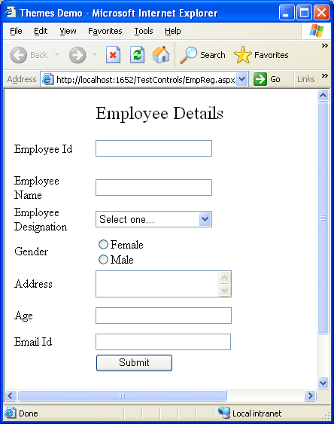
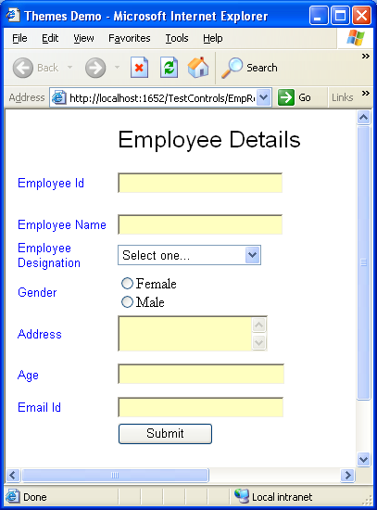
Applying Themes to Page
<%@ Page Language="C#" Theme ="SkinFile" AutoEventWireup="true" CodeFile="EmpReg.aspx.cs" Inherits="EmpReg" %>
Before
After
Notes:
Programming ASP.NET
Copyright © 2001-2002

Slide 14
Applying Theme to Site
Web.config
<configuration>
<appSettings/>
<system.web>
<pages theme ="BlueCalm"/>
</system.web>
</configuration>
Applying Theme Programmatically
void Page_PreInit (Object sender, EventArgs e)
{
Page.Theme = "BasicBlue";
}
Notes:
Programming ASP.NET
Copyright © 2001-2002

Slide 15
Custom Themes
Sub folder name specified
<%@ Page Language="C#" Theme = “Summer" AutoEventWireup="true" CodeFile="EmpReg.aspx.cs" Inherits="EmpReg" %>
App_Themes
Summer
SKIN
SKIN
Cool Breeze
SKIN
SKIN
Notes:
Programming ASP.NET
Copyright © 2001-2002

Slide 16
Skin File
<!-- Default look for DropDownList controls -->
<asp:DropDownList runat="server" BackColor="hotpink" ForeColor="white" />
<!-- Default look for DataGrid controls -->
<asp:DataGrid runat="server" BackColor="#CCCCCC" BorderWidth="2pt"
BorderStyle="Solid" BorderColor="#CCCCCC" GridLines="Vertical"
HorizontalAlign="Left">
<HeaderStyle ForeColor="white" BackColor="hotpink" />
<ItemStyle ForeColor="black" BackColor="white" />
<AlternatingItemStyle BackColor="pink" ForeColor="black" />
</asp:DataGrid>
...
.skin file
Notes:
Programming ASP.NET
Copyright © 2001-2002

Slide 17
EnableTheming Property
Supported by all pages and controls
Defaults to true
To disable theming for individual controls or entire pages, set the property to False value
<%@Page Language = “C#” EnableTheming = “False” />
<asp:DropDownList ID="Countries" EnableTheming=“False"
runat="server" />

Slide 18
Quick Recap
Master pages are an easy way to provide template that gives consistent look for some or all pages in a web application.
Master Page can be applied at individual page level as well as for an entire site.
Master Page can be nested.
Skins and Themes give a consistent look to the controls in a web application.
Themes can also be applied at page level as well as application level.
Theming can be disabled by setting the EnableTheming property to false for a control or page.

